Slide 1
Executive Summary
Problem Statement:
Master Data Management (MDM) license funding commitment is required to move forward with MDM Platform contract and purchase
Background:
Reltio is identified as a SaaS vendor platform for the Master Data Management capability
As per the NG Procurement and Commercial teams, the Reltio contract negotiation will start only after the funding confirmation
Procurement and commercial teams will start the contract discussion with Reltio starting next week (week of 4/12)
Any material delay puts the risk of delivering the MDM platform to the key business initiatives like AMI, Grid Mod, Workforce Data Domain, Customer Transformation and other programs

Slide 2
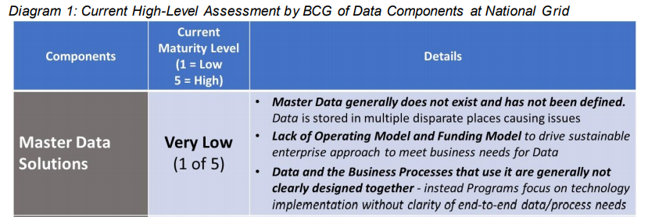
Why Master Data Management?
Based on April 2020 work by Boston Consulting Group, National Grid rates “low” or “very low” across the three major components of Data (Master Data Solutions, Data Governance, and Data Tools & Platforms). BCG’s study, that looked into a subset of the Data domains at National Grid, estimated the costs of bad Data at $73-98M. Given the limited scope of their review, they concluded that the full cost is likely much higher.”

Slide 3
Master Data Management Platform Selection and Timeline
Tools
FY 2021
FY 2022
20’ Aug
Sept
Oct
Nov
Dec
21’ Jan
Feb
Mar
21’ April
May
June
Jul
Aug
Sept
Finalist - Informatica and Reltio are Selected On 11/19/2021
Consolidate MDM
Use Cases/ Capabilities
Complete Vendor Demos
Select top 2 Vendors
Consolidate User, Security, and Commercial scores
Reltio is Selected MDM Vendor
Create MDM Use Cases for
Final Demo and Start Base Security Commercial
Complete Final Vendor Demos
Select Final
MDM Tool
Complete Security Assessment
Funding
Approval
Sign Contract
Build MDM Environment, Complete NG Connectivity and SSO Integration

Slide 4
Master Data Management Proposed Roadmap (Draft)
Tools
2021
2022
Jan
Feb
Mar
April
May
June
Jul
Aug
Sept
Oct
Nov
Dec
Jan
Feb
Mar
April
May
Jun
Jul
Complete Security Assessment, Contact & Get Funding
MDM Tool
Select
The Tool
MDM Environment
Ready to use
Working with MDM Vendor Prof Service to plan 4 months 1st MVP with customer
US Customer
Master Data
MVP
Release 1
Approve
Implementation Funding
MDM
Pre-work
MVP
Release 2
MVP
Release 3
Working with MDM Vendor Prof Service to plan 3 months 2st MVP with US Asset
US Asset
Master Data
Pre-work
Approve
Implementation Funding
MVP
Release 1
MVP
Release 2
Global Workforce
Master Data
Approve
Implementation Funding
Pre-work
MVP
Release 1
MVP
Release 2
UK Asset
Master Data
Approve
Implementation Funding
Pre-work
MVP
Release 1

Slide 5
Master Data Management Platform Business Demand
AMI
Domains: Customer, Asset, Location, Workforce, Reference
Allocated MDM license cost in FY2022 approved budget
Required by Jun/Jul 2021
GridMod
Domains: Asset, Location, Workforce, Reference
Allocated MDM license cost in FY2022 approved budget
Required by Jun/Jul 2021
US Customer Transformation
Domains: Customer B2C, Workforce, Vendor, Product, Reference
FY2022 Business case includes MDM license cost
IAM
Domains: Workforce, Reference
Workforce Data Domain
Domains: Workforce, Reference
FY2022 Business case has included MDM license cost
Digital Enablement
Domains: Customer, Workforce, Asset, Location, Reference
Programs: OnMyWay, FutureNow, VMO, Smart Target etc.
RIO based UK-ET and UK-GT initiatives
Domains: Customer B2B, Workforce, Asset, Location, Vendor, Product, Reference
ESO
Domains: Customer B2B, Workforce, Asset, Location, Reference
Energy Efficiency/Clean Energy initiative
Domains: Customer, Workforce, Reference

Slide 6
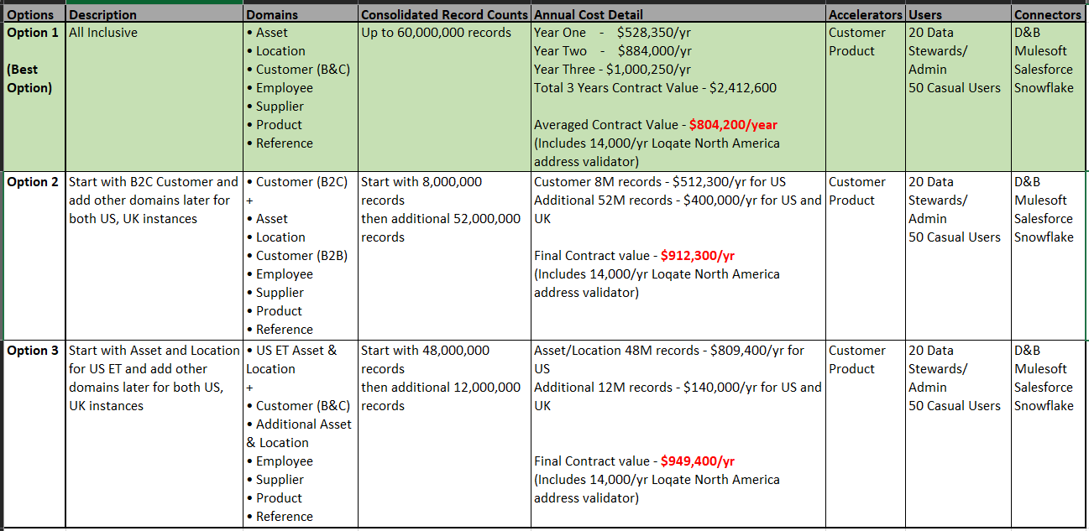
Reltio License Cost Options

Slide 7
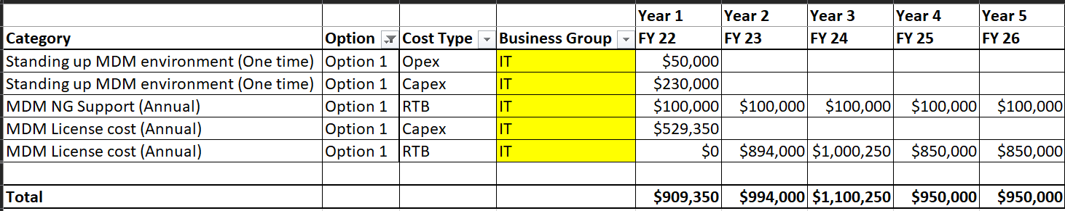
Funding Options (for All-inclusive Reltio License)
Option 1: MDM license cost is completely funded from IT4IT budget

Slide 8
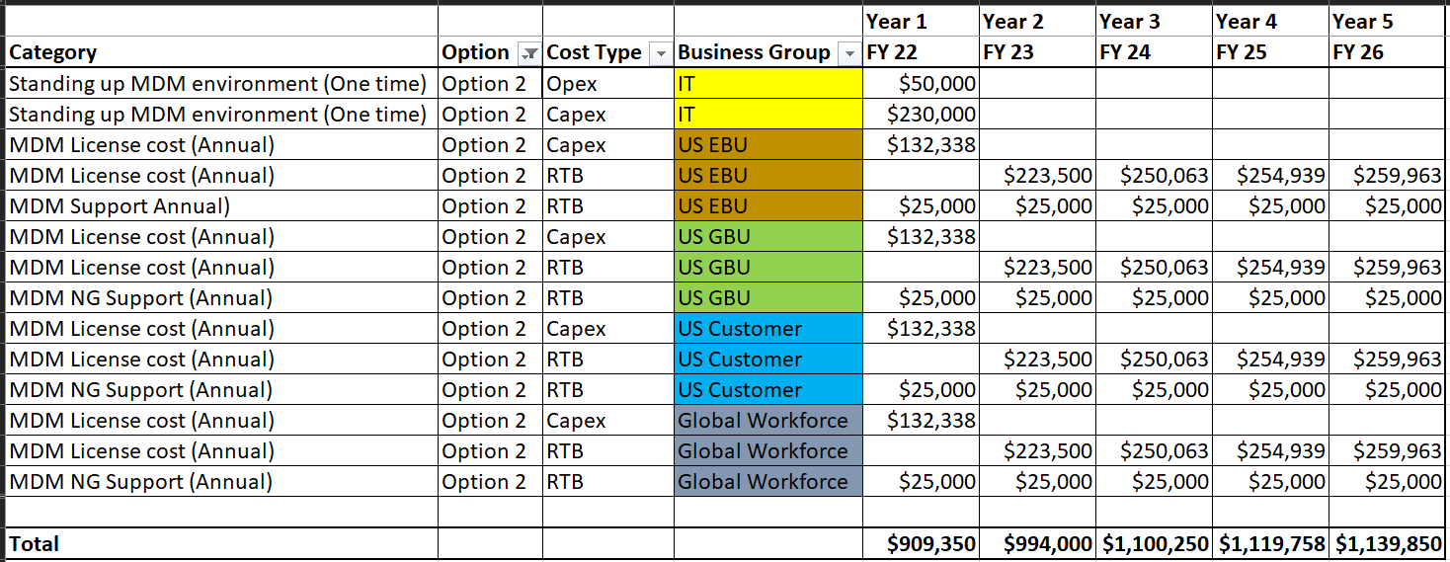
Funding Options (for All-inclusive Reltio License)
Option 2: Equally share annual license cost across all business domains (US ET, US GT, US Customer, Global Workforce)

Slide 9

Funding Options (for All-inclusive Reltio License) - Recommended
Option 3: License cost by each business domain as per their record counts

Slide 10

Funding Options – No shared/enterprise MDM platform
Option 4: Individual program to stand up its own MDM environment
Possibility of multiple different MDM platforms & vendors and associated standing up costs
Overall costly option (double the cost) with increase license and operating support costs
Project delivery time will be much longer

Slide 11
Funding Options - No MDM platform
Option 5a: Each program to not build MDM Solution and functionality
Possibility of having multiple different homegrown MDM solution
Project delivery time will be much longer
Estimated $73-98M costs of bad Data continues
Option 5b:Each program to build MDM Solution and functionality
Possibility of having multiple different homegrown MDM solution
Project delivery time will be much longer
Increase operating support cost
Estimated cost is between Option 4 or Option 5a

Slide 12
Next Steps
Go decision:
MDM tool purchase
Complete procurement process
Sign contract and legal agreements
Initiate standing the MDM environment
Engage professional service
Engage internal production management team
Establish NG connectivity
Initiate MVP with business programs – Grid Mod and AMI
Engage program manager and finalize plan
No go decision:
Option 4 or 5a/5b is implicit decision

Slide 13
Assumptions
Annual all-inclusive average license cost is $804,200/year for the 60M profiles (unique records/profiles) and both US, UK instances with DEV, TEST, and PROD environments
License cost is based on the final best offer received from the Reltio and will be adjusted once final contract is signed
Average license cost includes $14,000/year North America Loqate postal address validator
Average license cost includes 20 Data Stewards/Admin users and 50 Casual Users
Additional records/profiles will increase annual license cost
Additional users will increase annual license cost
Average license cost does NOT include implementation cost of any data domain and it will be each program/project responsibility
UK MDM instance cost is included but need to evaluate all requirements (record counts, users) when we work on it either by end of FY2022 or beginning of FY2023
Additional $55,000/year for the Western Europe Loqate address validator for UK MDM
Annual NationalGrid MDM support cost will be $100,000/year
Azure support is starting in Q3 of year 2021 so if we start implementation before that we will leverage AWS
NG is signing only 3 years contract with Reltio so cost for 4th and 5th year is estimated cost and can change.

